Slide 1

Go, change the world
RV College of
Engineering
Design of RC Coupled Amplifier
Summer Internship Presentation
Student Name: Pavan Kumar C Banasode (1RV21EC116)
Guide Name: Dr. Shilpa D R
Designation: Associate Professor
Department of Electronics and Communication Engineering
*
Department of ECE
1

Slide 2

Go, change the world
RV College of
Engineering
Outline
Certificate of Completion
Profile of the organization
Activities of the organization
Tasks performed
Project work undertaken
Outcome of internship
*
Department of ECE
2

Slide 3
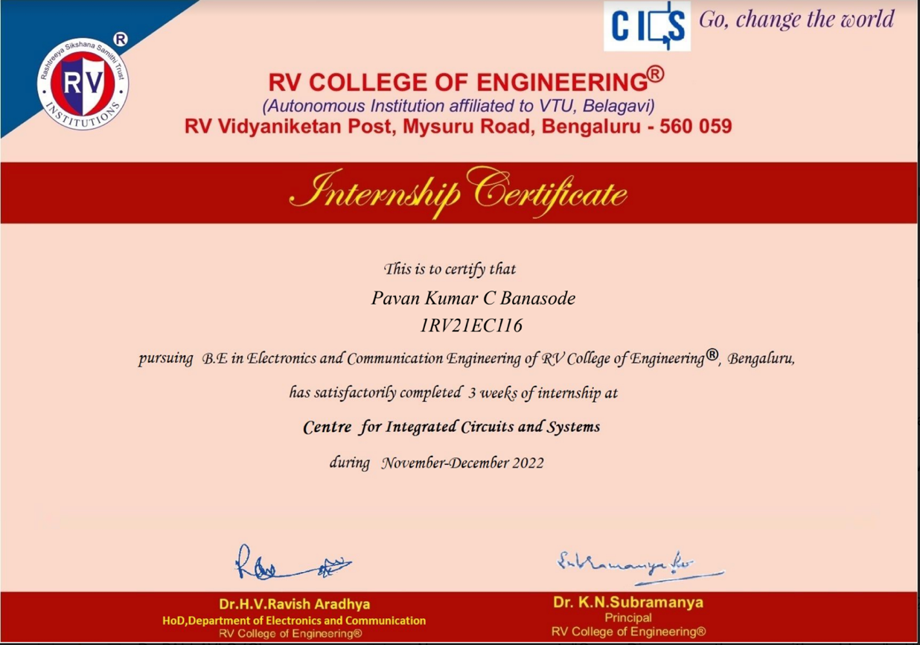
Go, change the world
RV College of
Engineering
Certificate of Completion of Internship
*
Department of ECE
3

Slide 4
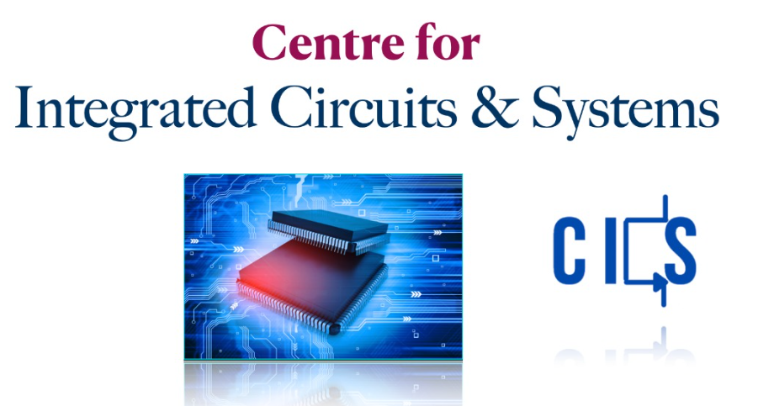
Go, change the world
RV College of
Engineering
Profile of the organization
The internship was carried out for three weeks in Centre for Integrated Circuits and Systems which specializes design, analysis, and optimization of digital and analogue circuits. The COE offers projects in the areas of Digital, Analog, and Mixed Signal mode VLSI design.
The CoE promotes a coherent training program that enhances the skill set of young designers in the specified areas with academia-industry collaboration in India and abroad.
Vision: Creating an ecosystem that inspires the VLSI/Electronics system designer, nurturing their skills and innovative ideas, and promoting sustainable and interdisciplinary research, with inclusive societal concerns.
The Centre also promotes Interdisciplinary Research by aligning with existing infrastructure and identifying new infrastructure needed and developing Modules and providing training.
*
Department of ECE
4

Slide 5
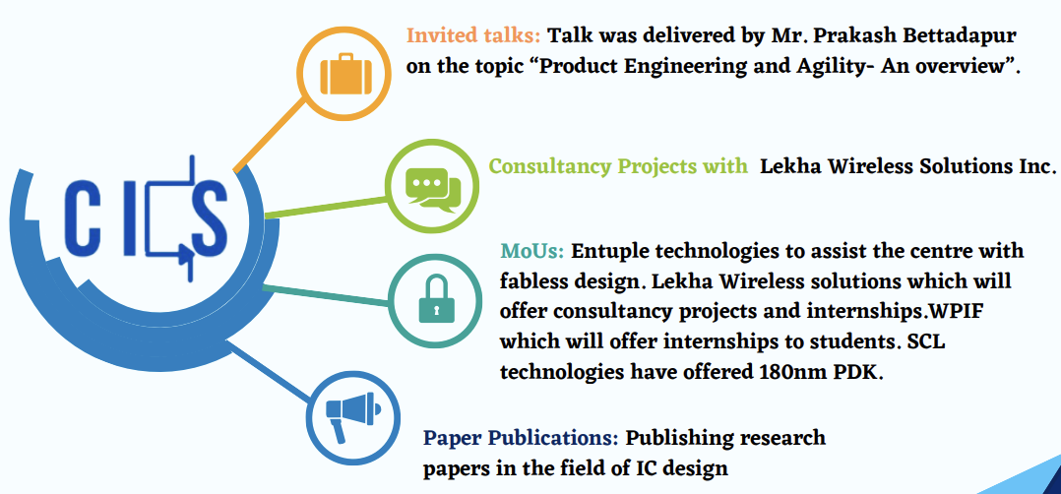
Go, change the world
RV College of
Engineering
Activities of the Organization
Provide internship to undergraduate and postgraduate students
Invited talks, consultancy projects with Lekha Wireless Solutions Inc.
MoUs with several leading tech companies
Paper publications in the field of IC.
Provide training programmes to undergraduate and post-graduate students.
Image source: https://rvce.edu.in/sites/default/files/RVCE-CoE-Brochure.pdf
*
Department of ECE
5

Slide 6
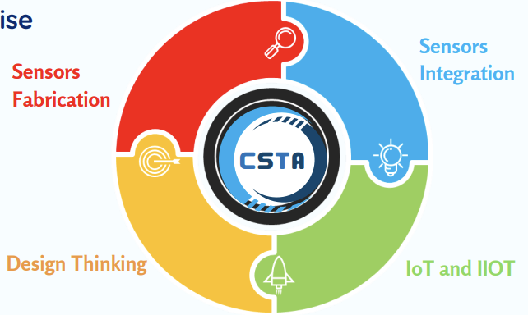
Go, change the world
RV College of
Engineering
Activities of the Organization
Research Collaboration
The centre is well-equipped with skilled staff, computing infrastructure, and appropriate open source and commercial teaching learning tools.
The proposed Centre works on research projects related to sensors fabrication, sensor integration, design thinking and IoT & IIoT related.
Modules in Training Programme
The proposed centre conducts training programmes for undergraduate as well as post-graduate students.
It consists of two modules, each containing individual levels.
Courses Offered by CoE
The circuit branches of EC, EE, EI and ET have the foundation courses in the areas of IC Design in the curriculum so that any student from circuit branch can make use of the facility available in the centre.
The curriculum of ECE has the specialised courses of the centre as core and electives.
UG Courses
1 | Analog Microelectronic Circuits (with lab)
2 | Analog Integrated Circuits Design
3 | Mixed Signal IC Design
4 | Radio Frequency & MMW Integrated Circuit Design
5 | VLSI Testing for ICs
PG Courses
1 | Analog Integrated Circuits Design (with lab)
2 | Radio Frequency Integrated Circuit Design
3 | Digital IC Design
4 | VLSI Testing and Testability
*
Department of ECE
6

Slide 7
Go, change the world
RV College of
Engineering
Tasks performed during internship
Analysis of RLC networks
Workshop on LTSpice simulation software.
Analysis and simulation of analog and digital circuits in LTSpice software.
Introduction to Verilog.
Weekly assignments based on the conducted classes.
Webinar on MOSFET Fabrication addressed by Ms. Sabiha Sultana, Prof., IISc.
Visit to IDRC Lab.
Project to design RC Coupled Amplifier.
*
Department of ECE
7

Slide 8
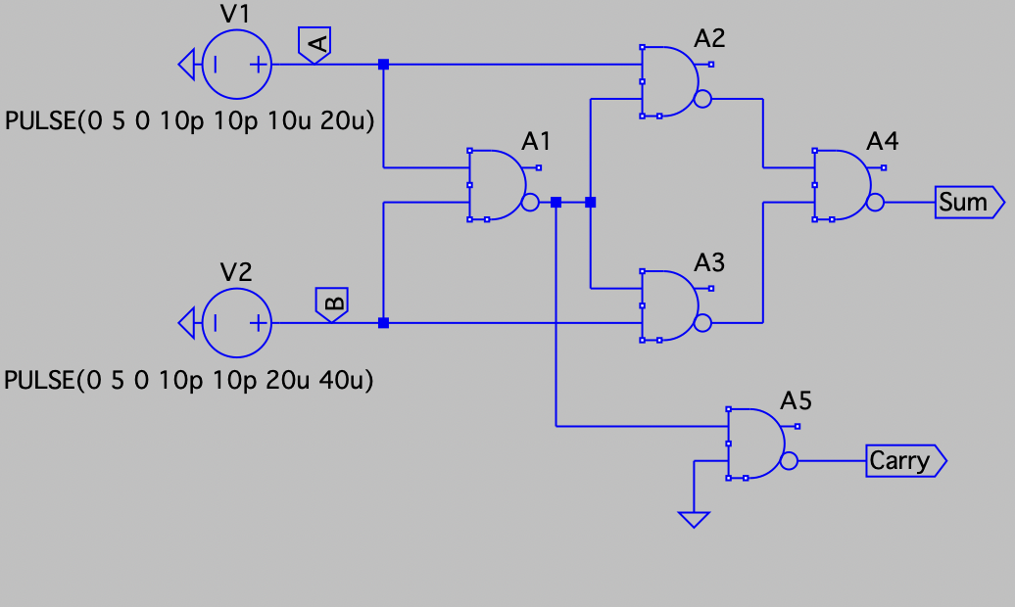
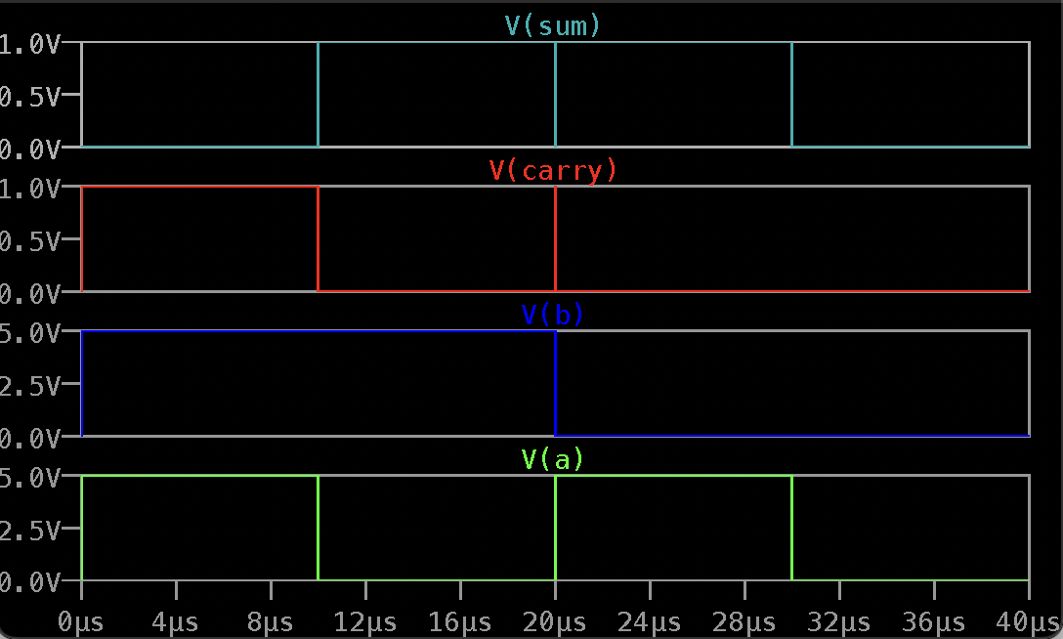
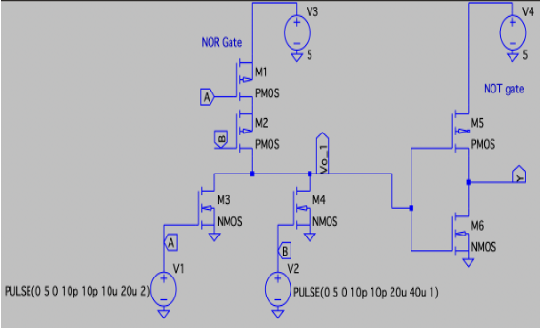
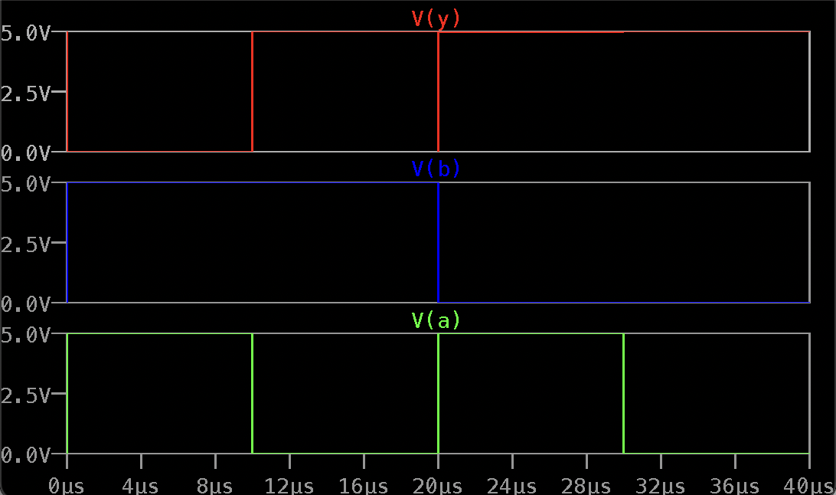
Go, change the world
RV College of
Engineering
Design and Analysis of Analog and Digital Circuits using LTspice
Half adder using NAND gates and simulation waveform
OR gate using CMOS OR and NOT gates and simulation waveform
*
Department of ECE
8

Slide 9
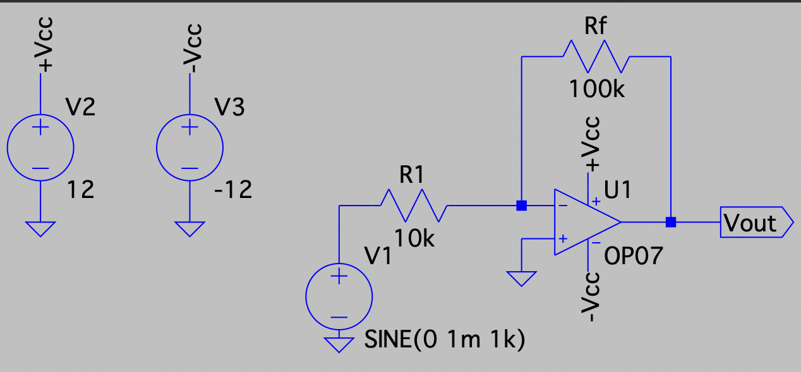
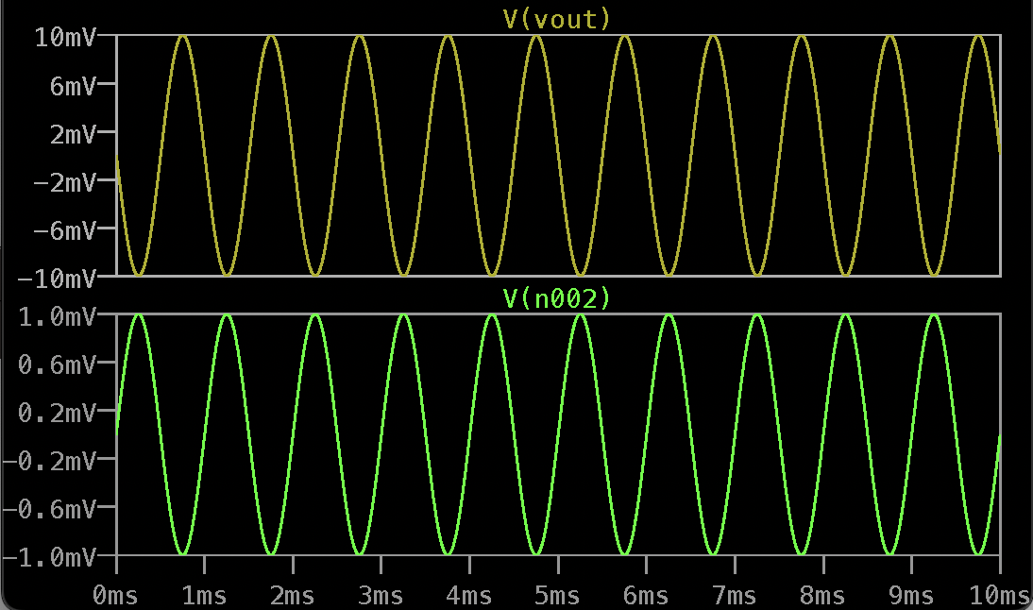
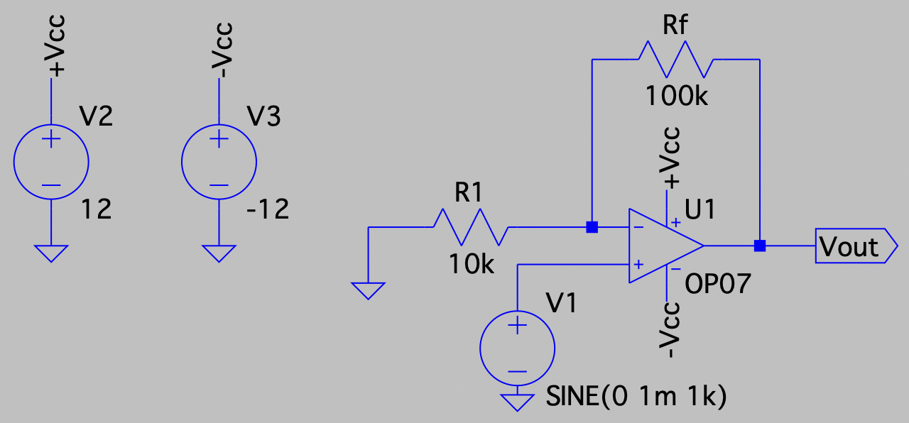
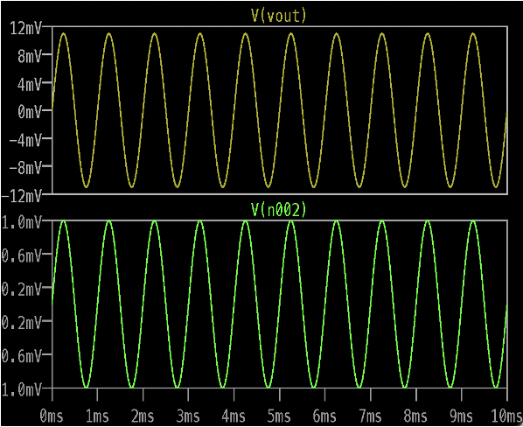
Go, change the world
RV College of
Engineering
Design and Analysis of Analog and Digital Circuits using LTSpice
Inverting amplifier using Operational Amplifier and simulation waveform
Non-inverting amplifier using Operational Amplifier and simulated waveform
*
Department of ECE
9

Slide 10
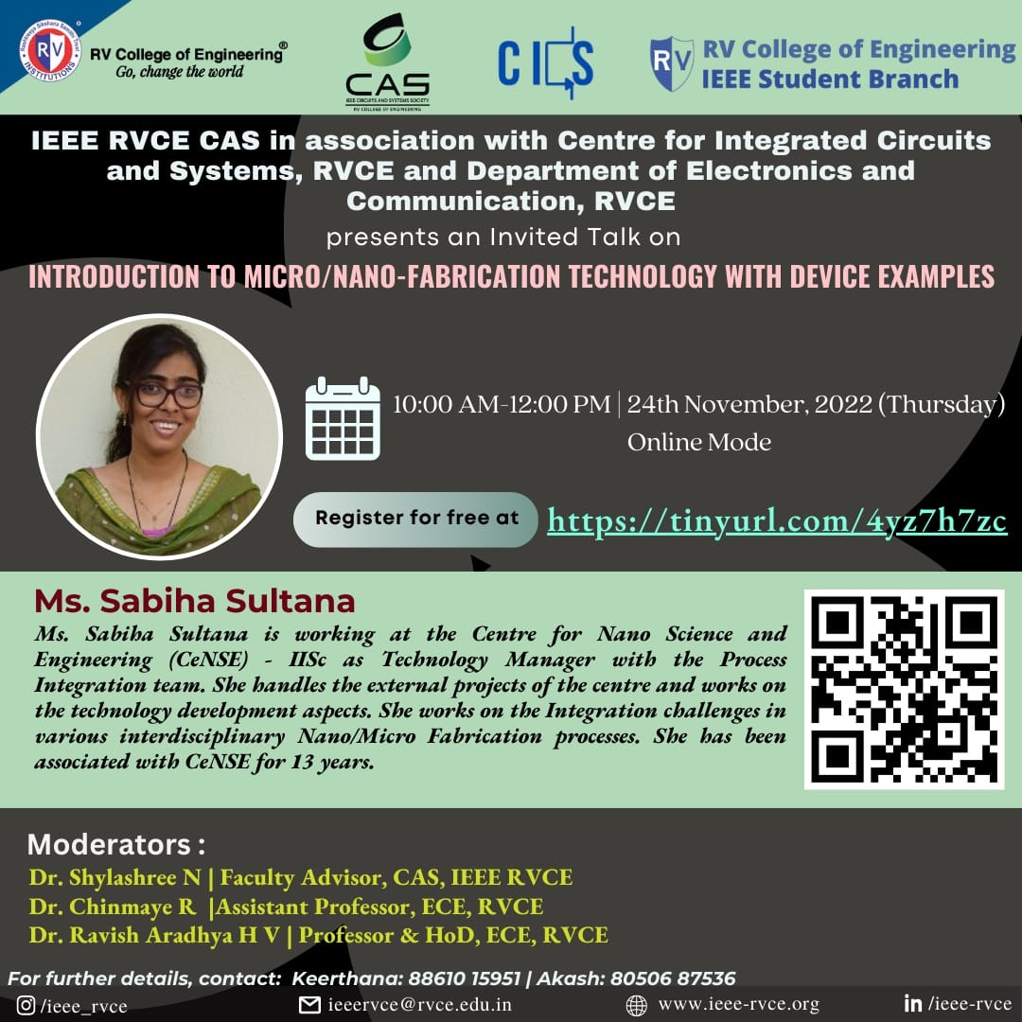
Go, change the world
RV College of
Engineering
Webinar on Fabrication Technology, by Ms.Sabiha Sulthana
*
Department of ECE
10

Slide 11
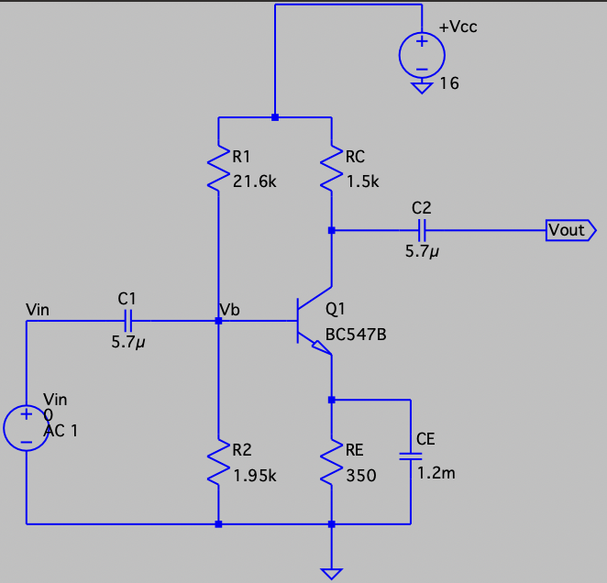
Go, change the world
RV College of
Engineering
Project to design RC Coupled Amplifier
*
Department of ECE
11

Slide 12
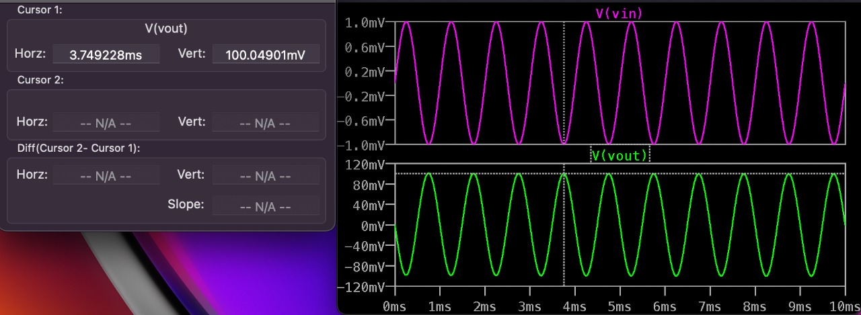
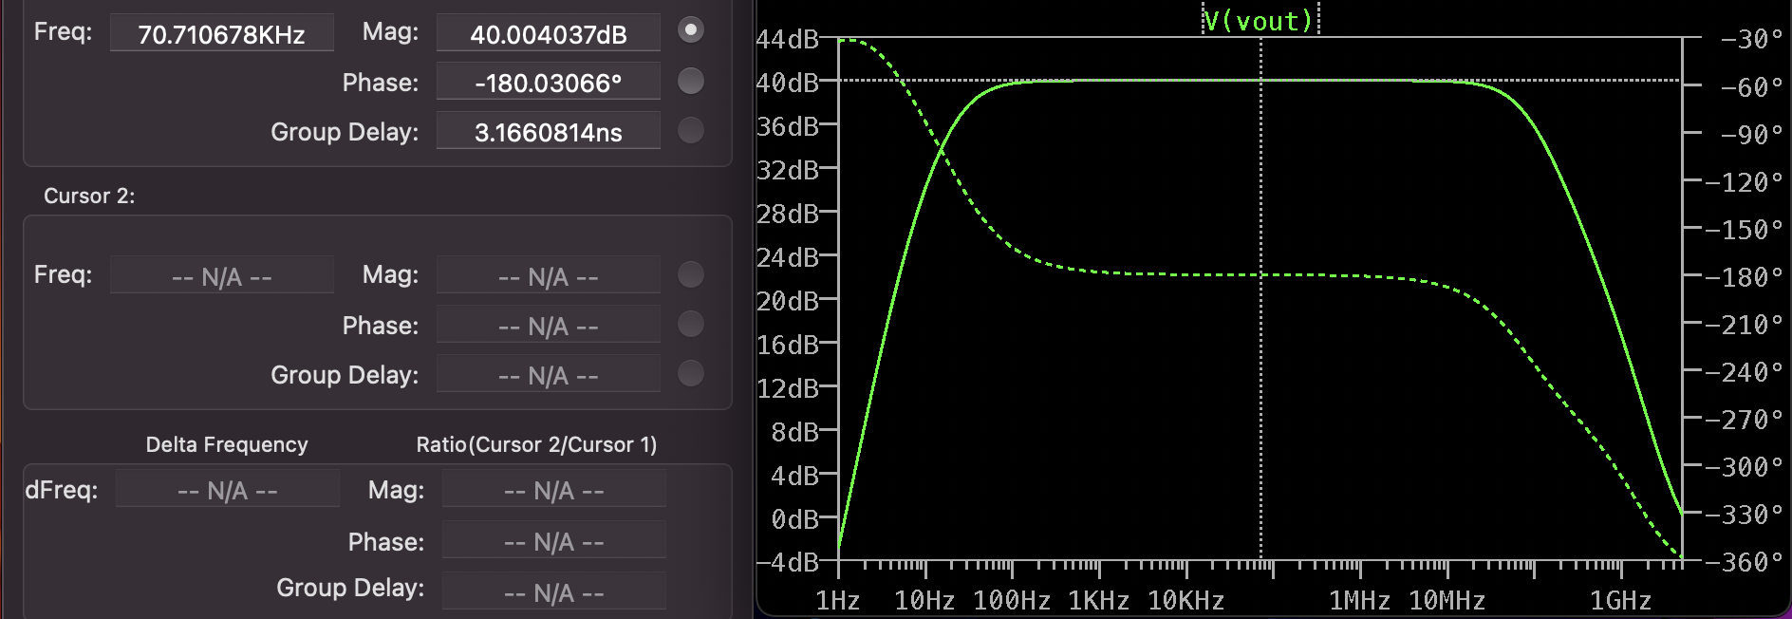
Go, change the world
RV College of
Engineering
Project to design RC Coupled Amplifier
Input v/s Output waveforms
Frequency response curve of the designed RC coupled amplifier
*
Department of ECE
12

Slide 13
Go, change the world
RV College of
Engineering
Project to design RC Coupled Amplifier
Results
RC coupled CE amplifier was designed and its operation was verified. The circuit was simulated using LTspice software and theoretical values were verified. The obtained value of gain and bandwidth after simulation was equal to 100 i.e., 40dB, and 117MHz respectively.
Circuit | Gain | Bandwidth
RC Coupled amplifier | 100.07 | 117MHz
Conclusions
The inference of the project undertaken during the internship program was that when designing analog circuits and systems, several variables have to be taken into consideration. In the case of RC coupled amplifier, There is a trade-off between gain, bandwidth and the operating point of the transistor used. Keeping all of this in mind, an optimal solution/design has to be developed which is fast as well as efficient in its operation.
*
Department of ECE
13

Slide 14
Go, change the world
RV College of
Engineering
Advantages
Disadvantages
The RC coupled amplifier offers a constant gain over a wide frequency band.
The circuit is very compact and extremely light.
It used the resistor and the capacitor which are not expensive so the cost is low.
The frequency response of RC coupled amplifier is excellent.
The RC coupled amplifier has poor impedance matching because its output impedance is several times larger than the device, at its end terminal.
It is unsuitable for low frequency application.
It has low voltage and power gain.
It has narrow bandwidth.
It has the tendency to become noisy at times.
Applications
RF Communications.
Optical Fiber Communications.
Public address systems as pre-amplifiers.
Widely used as Voltage amplifiers
Radio or TV Receivers as small signal amplifiers.
*
Department of ECE
14

Slide 15
Go, change the world
RV College of
Engineering
Outcome of the Internship
Design and implementation of various analog and digital circuits in LTspice: Implementation of the most basic circuits in LTspice, and building more complex systems by utilizing the basic circuits
Fabrication of MOSFETs: The various techniques involved in the different steps of MOSFET fabrication, the existing technology and future scope of improvements in terms of reduction in size and subsequent increase in performance.
Implementation of various combinational digital circuits such as MUX, DEMUX, encoder, decoder, adders, subtractors: These basic circuits form the basis of all the complex circuits that can be built, and are an integral part in the design of any digital circuit.
Implementation of various sequential digital circuits: Flip-flops and latches are used extensively as memory units or registers. They are used to implement counters, shift registers, analog to digital converters, digital to analog converters, clocks, etc.
Optimization techniques: Various techniques such as pseudo NMOS logic, pass transistor logic, and transmission gate logic which are used to optimize parameters such as power consumed, area occupied, cost, etc.
Verilog programming: Three types of modelling - behavioral modelling, dataflow modelling, structural modelling, and implementation of basic circuits.
*
Department of ECE
15

Slide 16
Go, change the world
RV College of
Engineering
Thank You
*
Department of ECE
16

